Slide 1
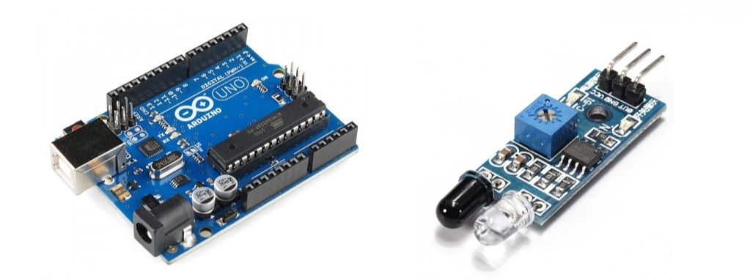
Team robolution project.
Detecting obstacle With IR sensor And arduino .

Slide 2
Topics..
Introduction
Hardware description.
Software description.
Arduino code.
Circuit description.
Applications.
Pros and cons.

Slide 3
Introduction..
This project and its circuit are one of the most basic popular Sensor module. In electronics this sensor analogous to Human’s visionary Which can be used to detect an obstacle, Which is one of the most common application. In robotics, a group of such modules are used so that a robot can follow a line pattern.

Slide 4
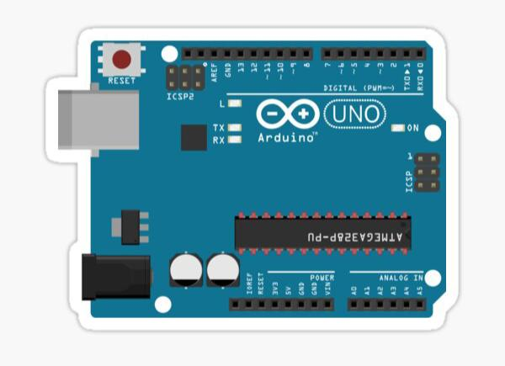
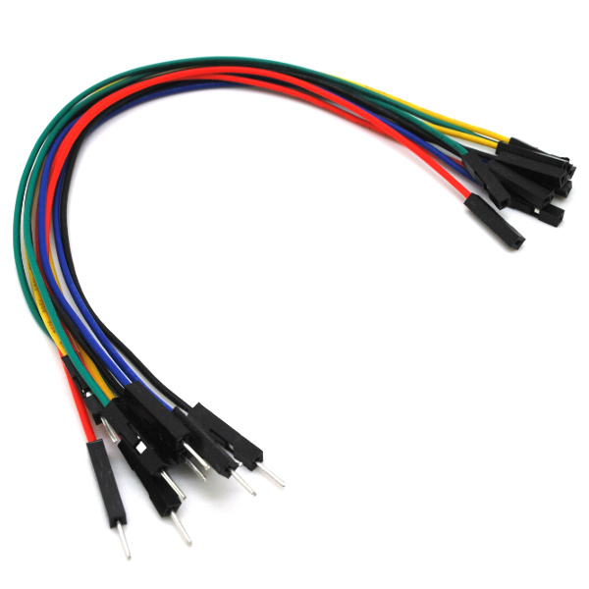
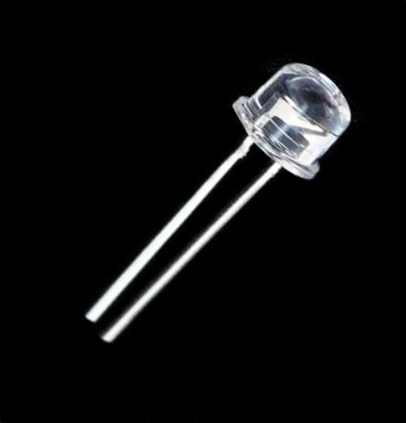
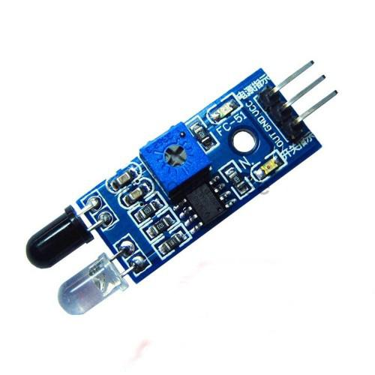
Hardware description..
Arduino uno.
IR sensor.
Led.
Jumper wires.
Power supply.

Slide 5


Software description..
Arduino IDE software.
Proteous software for simulation.

Slide 6
Arduino code..
Int ir=2;
Int redled=13;
void setup(){
Serial.begin(9600);
pinMode(ir,INPUT);
pinMode (redled,OUTPUT);
}
void loop(){
int v= digitalRead(IR);
if (v==HIGH){
digitalWrite(redled,HIGH);
}
Else{
digitalWrite (redled,LOW);}
}

Slide 7
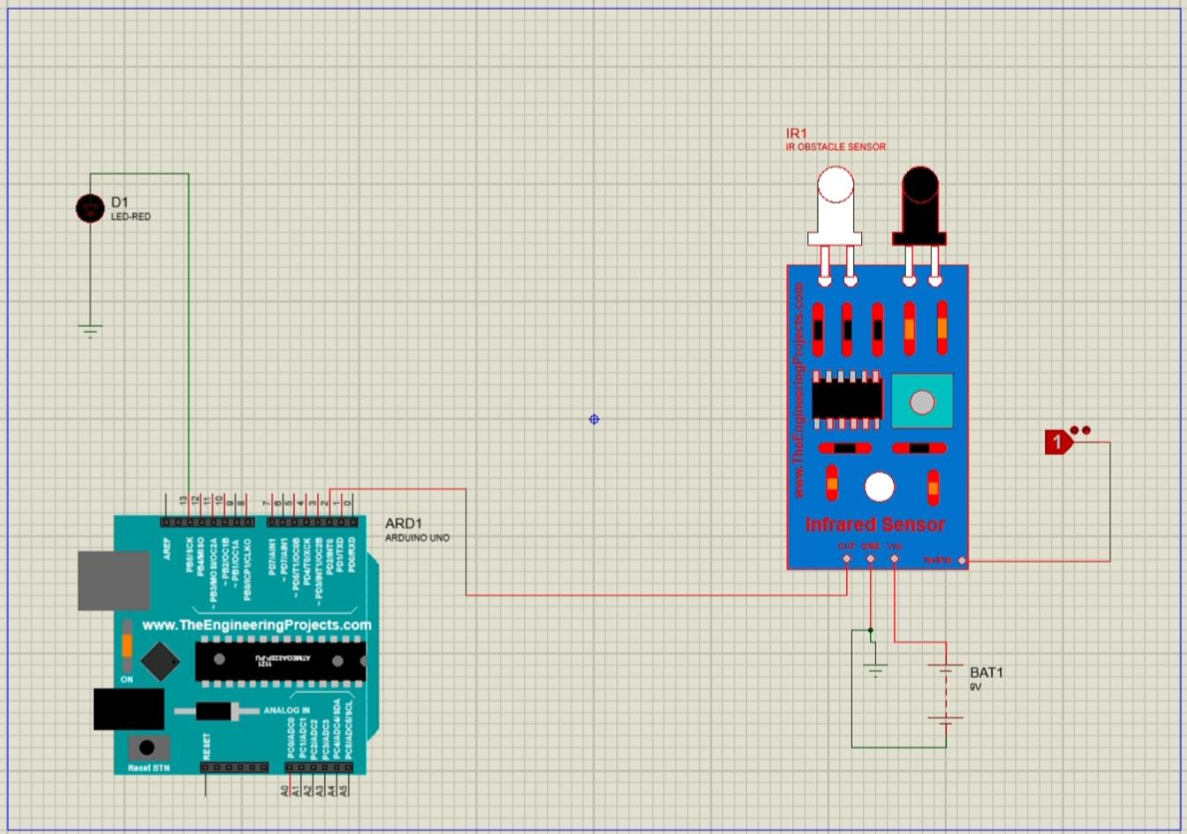
Circuit description..

Slide 8
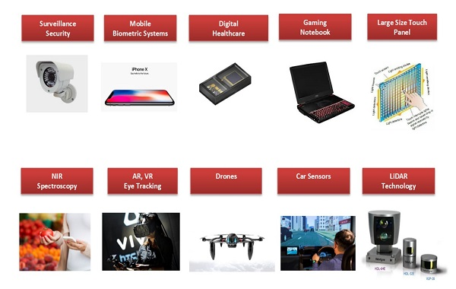
Applications..
Surveillance security.
Mobile biometric system
Drones.
LIDAR technology.
Digital healthcare.
Obstaclee detector.
In robotics.
Distance measurement.
Brightness comparison.

Slide 9
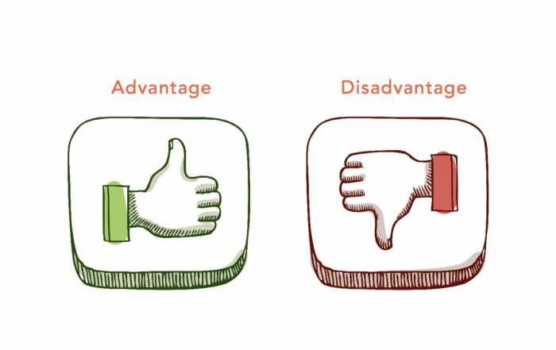
Pros and cons..
Advantages.
Low power requirement.
Simple circuitery.
Direction Beam.
High noise immunity.
Disadvantages.
Line of sight requirement.
Short range.
Blocked by common object.
Easily affected by physical environment.

Slide 10
Thank you…
Team members are:
Kavya Gupta.
Vikas chauhan.
Akshat Jain.

